Slide 1


Full Stack Web Development Workshop
using JavaScript, Node.js, React, MongoDB
By
Varma Bhupatiraju
Founder & Lead Instructor
C
d
n
g
S
t
r
o
i
a
s
a
Ignites Passion To Learn

Slide 2

About Me
B Tech from SVU, M Tech from IIT, New Delhi
20+ years of professional software development experience
in Los Angeles, USA
CEO @ Stellent Soft Pvt Ltd, Vizag
Varma Bhupatiraju
CEO & Lead Instructor
Founder & Lead Instructor @ Coding Sastra, Vizag
Lead Organizer of Vizag Software Developers & Hyderabad Software Developers meetups on meetup.com
Previously worked for Fortune 100 companies
American Honda
Public Storage
Aramark
Keane Inc
UBM Medica

Slide 3
Agenda

Slide 4
Agenda
Day 1
Day 2
JavaScript
React
MongoDB
Node

Slide 5
How internet works?

Slide 6
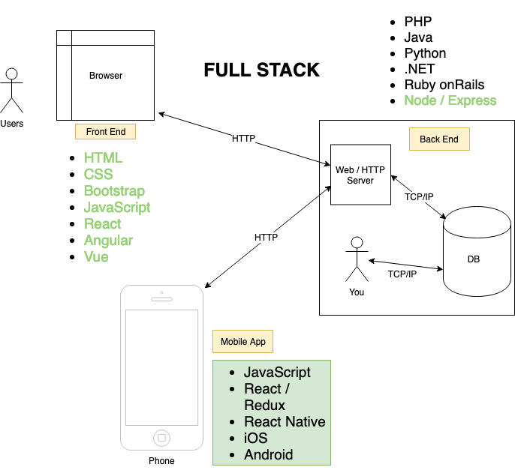

Slide 7
JavaScript

Slide 8
JavaScript
Variables
Types
Operators
Loops
Conditionals
Functions
Objects
Strings
Arrays
History
Why JavaScript?
HTML/CSS vs JavaScript
Java vs JavaScript
How to include?
Console & Debugging
ECMAScript
Scope
Prototype
this
DOM
jQuery
ES6

Slide 9
History
Created in 1995
By Brendan Eich at Netscape
Originally dismissed as gimmick & unstable
By 2000, People began to realize its power
Later standardized and more browsers starting to support
Standard is named as ECMAScript, implementation of ECMAScript in browser is JavaScript
Currently ES5 is running, but ES6 released in 2015. Brower companies almost completed implementation of ES6 at 99%.
We will start with ES5, but will learn some ES6 as well.

Slide 10
History
More open source frameworks & libraries developed using JS
jQuery (2006)
Backbone (2010)
Ember.js (2013)
Node.js (2009)
Angular.JS (Google) (2010)
React.js (Facebook) (2013)

Slide 11
Why JavaScript?
Fun
Easy to learn
Popular
Enterprise Adoption
Uber
Facebook
Instagram
Google
Paypal
and many more..

Slide 12
HTML/CSS vs JavaScript​
Noun – HTML
Adjective – CSS
Verb - JavaScript

Slide 13
Java vs JavaScript

Slide 14
How to include JavaScript in HTML?
You can include JavaScript in your HTML in two ways:
Inline JavaScript – inside html using script tag
External JavaScript File - include via src attribute of script tag

Slide 15
Console & Debugging
JavaScript Console
If your browser supports debugging, you can use console.log() to display JavaScript values in the debugger window:
Debugging
Programming code might contain syntax errors, or logical errors.
Many of these errors are difficult to diagnose.
Often, when programming code contains errors, nothing will happen. There are no error messages, and you will get no indications where to search for errors.
Searching for (and fixing) errors in programming code is called code debugging.

Slide 16
Variables
A container for a value
JavaScript is weakly/dynamically typed
No need to specify variable types
Variable types can change
Sometimes we don’t know a variable’s type

Slide 17
Types
Primitive Types
string
number
boolean
Special Types
undefined
null
Composite Types
[Arrays]
{Objects}

Slide 18
Operators
Arithmetic Operators
Comparison Operators
Logical (or Relational) Operators
Assignment Operators
Conditional (or ternary) Operators

Slide 19
Arithmetic Operators
Add +
Substract -
Devide /
Multiply *
Modulus %
Increment ++
Decrement --

Slide 20
Comparision Operators
== (double equal)
!= (double not equal )
=== (triple equal)
!== (triple not equal )
> (greater than)
< (less than)
>= (greater than or equal)
<= (less than or equal)

Slide 21
Logical Operators
&& (logical AND)
|| (logical OR)

Slide 22
Assignment Operators
+=
-=
%=
/=

Slide 23
Loops
Loops can execute a block of code a number of times.
for - loops through a block of code a number of times
for/in - loops through the properties of an object
while - loops through a block of code while a specified condition is true
do/while - also loops through a block of code while a specified condition is true

Slide 24
Conditionals
Conditional statements are used to perform different actions based on different conditions.
Use if to specify a block of code to be executed, if a specified condition is true
Use else to specify a block of code to be executed, if the same condition is false
Use else if to specify a new condition to test, if the first condition is false
Use switch to specify many alternative blocks of code to be executed

Slide 25
Functions

Slide 26
Objects

Slide 27
Arrays
Composite Data Types
Container for multiple values​
Fixed numerical indices​
Indices are zero-based​

Slide 28
Arrays
Working with Arrays
Arrays have properties and methods useful to working with Arrays

Slide 29
Arrays
Only one useful property - length​
var myNumbers=[“one”,”two”,”three”];​
console.log(myNumbers.length); ??​​

Slide 30
Arrays
Mutator Methods​​
Add new item to array​
myNumbers.push(“four”); ​
what will be our array now look like?
Add new item to beginning of array
??

Slide 31
Arrays
Mutator Methods​​
Add new item to array​
myNumbers.push(“four”); ​
what will be our array now look like?
Add new item to beginning of array
Add new item to beginning of array​
myNumbers.unshift(“zero”);

Slide 32
Arrays
Mutator Methods​​
Remove item from end of array​​
myNumbers.pop(); ​
what will be our array now look like?
Remove item from beginning of array​
myNumbers.shift();

Slide 33
Arrays
Mutator Methods​
splice - Add/remove items from anywhere in the array​
array.splice(index, howmanytoremove, newitem1,.....,newitemN);​
var myFruits=[“orange”,”apple”,”mango”,”banana”];​
myFruits.splice(2,0,”grape”,”strawberry”);​
myFruits.splice(2,1,”grape”,”strawberry”);

Slide 34
Arrays
Accessor Methods​​
Join the elements of array in to string
var myLetters=[“a”,”b”,”c”];​
myLetters.join(); ?? abc​
myLetters.join(‘ ‘); ?? a b c​
myLetters.join(‘|’); ?? a|b|c

Slide 35
Arrays
Accessor Methods​​
Find indices of items with indexOf / lastIndexOf​
var fruits = ["Banana", "Orange", "Apple", "Mango", "Apple"];​
var a = fruits.indexOf("Apple"); ​
a?​
a=fruits.lastIndexOf(“Apple”)​
a?​

Slide 36
Arrays
Accessor Methods​​
Use slice to return a subset of the array​​
var fruits = ["Banana", "Orange", "Apple", "Mango", "Apple"];​
var citrus = fruits.slice(1, 3);​
citrus?

Slide 37
Arrays
Iterator Methods​
forEach​
every​
some​
filter​
map​
reduce

Slide 38
Arrays
Iterator Methods​ :
forEach
calls a provided function once for each element in an array​
myNumbers.forEach(function(item,index) {​
console.log(“Item “ item + “ with index “ + index);​
});

Slide 39
Arrays
Iterator Methods​ :
every
checks if all elements in an array pass a test
var ages=[32,25,18,10];​
var isAllAdults = ages.every(function(age) {​
return age >= 18;​
});​
isAllAdults??​

Slide 40
Arrays
Iterator Methods​ :
some
checks if atleast one element of an array pass a test​​
var ages=[3,12,18,10];​
var isAnyAdult = ages.some(function(age){​
return age >= 18;​
});​
isAnyAdult??

Slide 41
Arrays
Iterator Methods​
filter
Creates an array filled with all array elements that pass a test
var ages=[3,12,18,22,10];​​ ​
var adultsOnly = ages.filter(function(age){​​
return age >= 18;​​ ​
});​​​
console.log(adultsOnly)

Slide 42
Arrays
Iterator Methods​ :
map
creates a new array with the results of calling a function for every array element​
var movies=[{ name: “bahubali”,actor: “prabhas”},
{name: “kick”,actor: “raviteja”},
{name: “Adhurs”,actor: “NTR”}];​
var actors= movies.map(function(movie) {
return {name:movie.actor};
});​
actors??

Slide 43
Arrays
Iterator Methods​ :
reduce
reduces the array to a single value​
var numbers=[1,2,3];​
var total = numbers.reduce(function(total,number) {
return total+number;
});​
total??

Slide 44
Strings

Slide 45
Scope
What is scope?
Scope: the life time of a variable's visibility & its value

Slide 46
Scope
var a = 2;
function foo() {
var a = 3;
console.log(a); ??
}
foo();
console.log(a); ??

Slide 47
Scope
var a = 2;
function foo() {
var a = 3;
console.log(a); //3
}
foo();
console.log(a); //2

Slide 48
Scope
var a = 2; //Global Scope
function foo() {
//Anything inside is local scope
var a = 3; //Local Scope
console.log(a); //3
}
foo();
console.log(a); //2

Slide 49
Scope
Global Scope
Any variables declared in top level are in global scope
Local Scope
Functions create local scope
JavaScript does not use block scope

Slide 50
Scope
var a = 2;
if(true){
//Block
var a=5;
}
function foo() {
var a = 3;
console.log(a); //3
}
foo();
console.log(a); //??

Slide 51
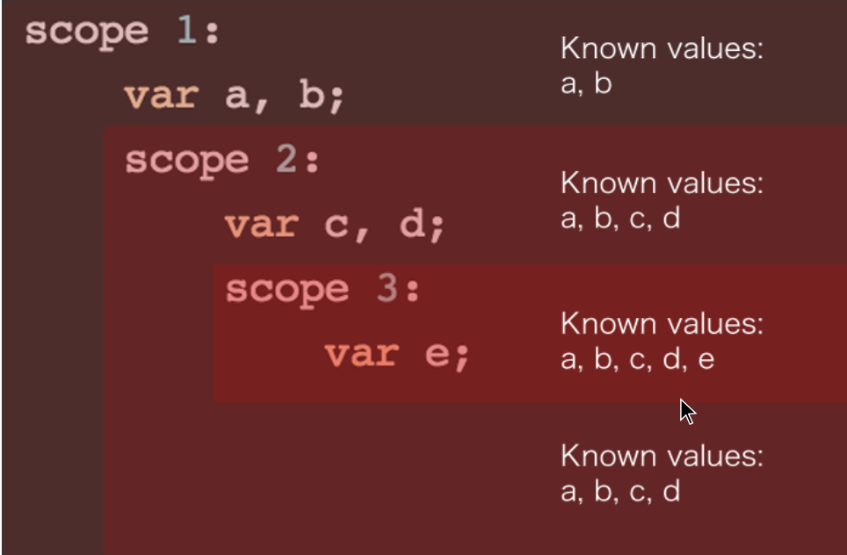
Scope

Slide 52
Scope
var x=10; //Know x
function squareSum(a,b){
//Know x, a, b
console.log("x:" + x);
console.log("a:" + a);
console.log("b:" + b);
function square(c) {
//Know x, a, b, c
console.log("x:" + x);
console.log("a:" + a);
console.log("b:" + b);
console.log("c:" + c);
return c*c;
} //Know x, a, b
return square(a) + square(b);
} //Know x only
squareSum(2,6);

Slide 53
Scope
For a variable to be local, it MUST
Be declared inside a function with var keyword
Be argument
function triple(a){
var sum=a+a+a;
return sum;
}

Slide 54
Scope
if variable not declared with var, it considered as global variable
var x=40;
function triple(a){
x=a+a+a;
return x;
}
console.log(x); //Guess

Slide 55
Scope
if variable not declared with var, it considered as global variable
var x=40;
function triple(a){
x=a+a+a;
return x;
}
triple(3);
console.log(x); //Guess

Slide 56
Scope
Global Scope
It is dangerous!!!
It pollutes scope and cause logic and data problems
It cause third party libraries malfunction if same variable names used in your own code.
So what should we do???

Slide 57
Scope
Trick: Self-Invoking Functions
(function(){
//This function runs as soon as it encountered //Gives me private scope
//Javascript will automatically excutes
//this block of code
//without needing to do seperate invokation
})();
Also called as IIFs (Immediately Invoked Functions)

Slide 58
Scope
Trick: IIFs
var a = 2;
if(true){ //Block
(function(){ //Private scope
var a=7;
console.log("a in IIF: " + a); //.....
})();
}
function foo() {
var a = 3;
console.log(a); //3
}
foo();
console.log(a); //??

Slide 59
Scope
Quiz Time

Slide 60
Scope
What gets printed?
var movie="Bahubali";
if(true){
var movie="Gabbar Singh";
}
console.log(movie); //??

Slide 61
Scope
What gets printed?
var movie="Bahubali";
if(true){
var movie="Gabbar Singh";
}
console.log(movie); //Gabbar Singh

Slide 62
Scope
What gets printed?
var movie1="Bahubali";
(function(){
var movie2="Gabbar Singh";
})();
console.log(movie2);

Slide 63
Scope
What gets printed?
var movie1="Bahubali";
(function(){
var movie2="Gabbar Singh";
})();
console.log(movie2);
//Error: movie2 is not defined

Slide 64
Scope
What gets printed?
var movie="Bahubali";
function printMovie(movie){ console.log(movie);
}
printMovie("Gabbar Singh");

Slide 65
Scope
What gets printed?
var movie="Bahubali";
function printMovie(movie){ console.log(movie);
}
printMovie("Gabbar Singh"); //prints "Gabbar Singh"

Slide 66
Scope
A VARIABLE IS GLOBAL IF IT IS NOT
Declared with 'var'
Declared inside a function

Slide 67
Scope
var movie1 = "Bahubali";
(function() {
// declaring without var
movie2 = "Gabbar Singh";
})();
console.log(movie2);
// ??

Slide 68
Prototype
What is prototype?
property of a function where you attach methods

Slide 69
Prototype
What is prototype?
function Person(){
this.firstName="Ramesh";
this.lastName="Kosuri";
}
Person.prototype.displayName=function(){
return this.firstName + " " + this.lastName;
}
function Student(school, grade){
this.school=school;
this.grade=grade;
}
Student.prototype=new Person();
var student=new Student('Chaitanya','10th'); console.log(student.displayName());

Slide 70
Prototype
Why you need to use prototype?
Every JavaScript function has a prototype property (this property is empty by default), and you attach properties and methods on this prototype property when you want to implement inheritance.

Slide 71
Prototype
What is prototype?
function Teacher(subject,city){
this.subject=subject;
this.city=city;
}
Teacher.prototype=new Person();
Teacher.prototype.teach=function(){
return "teaches " + this.subject + " and lives in " + this.city;
}
var teacher1=new Teacher('Javascript','Vizag'); console.log(teacher1.displayName() + " " + teacher1.teach());

Slide 72
this
It refers to an object; that is, the subject in context, or the subject of the executing code

Slide 73
this
when a function executes, it gets the this property—a variable with the value of the object that invokes the function where this is used.
var person = {
firstName :"Penelope",
lastName :"Barrymore",
// "this" will have the value of the person object
// because the person object will invoke showFullName()​ showFullName:function () {
console.log (this.firstName + " " + this.lastName);
}
} ​
person.showFullName (); // Penelope Barrymore

Slide 74
DOM
Objectives
Define what the DOM is
Understand why DOM Manipulation is awesome
List a few examples of sites that use JS to manipulate the DOM
Understand the SELECT, then MANIPULATE workflow

Slide 75
DOM
Why Should You Care?
A few examples:
Games
Scrolling Effects
Dropdown menus
Form Validations
Interactivity
Animations
Every awesome site ever

Slide 76
DOM
Document Object Model
The Document Object Model is the interface between your Javascript and HTML+CSS

Slide 77
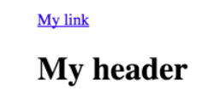
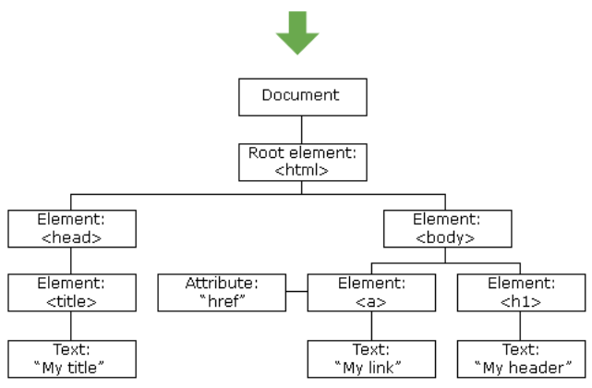
DOM
The browser turns every HTML tag into a Javascript object that we can manipulate
<!DOCTYPE html>
<html>
<head>
<title>My title</title>
</head>
<body>
<a>href="someLink">Mylink</a>
<h1>My header</h1>
</body>
</html>
Everything is stored inside of the document object

Slide 78
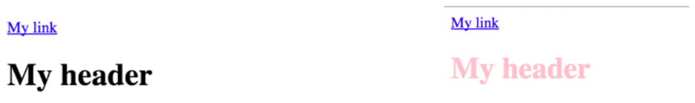
DOM
The Process :
SELECT an element and then MANIPULATE
<!DOCTYPE html>
<html>
<head>
<title>My title</title>
</head>
<body>
<a href="someLink">My link</a> <h1>My header</h1>
</body>
</html>
For our example, we'll change the <h1> color using JS

Slide 79
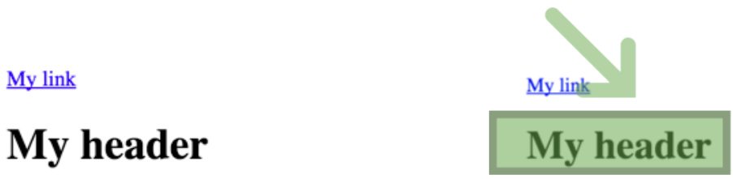
DOM
The Process :
SELECT an element and then MANIPULATE
var h1 = document.querySelector("h1");
SELECT the <h1> and save to a variable

Slide 80
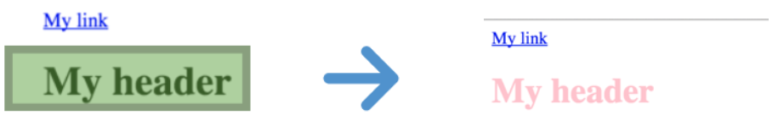
DOM
The Process :
SELECT an element and then MANIPULATE
var h1 = document.querySelector("h1");
h1.style.color = "pink";
MANIPULATE using the <h1> we selected

Slide 81
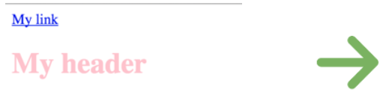
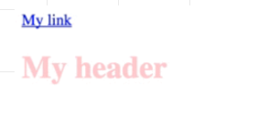
DOM
One more example :
SELECT the <body> and change its color every second
var body = document.querySelector("body");
//SELECT
var isBlue = false;
setInterval(function(){
//MANIPULATE if (isBlue) {
body.style.background = "white";
} else {
body.style.background = "#3498db";
}
isBlue = !isBlue;
} , 1000);

Slide 82
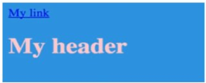
DOM
One more example :
SELECT the <body> and change its color every second
var body = document.querySelector("body");
//SELECT
var isBlue = false;
setInterval(function(){
//MANIPULATE if (isBlue) {
body.style.background = "white";
} else {
body.style.background = "#3498db";
}
isBlue = !isBlue;
} , 1000);

Slide 83
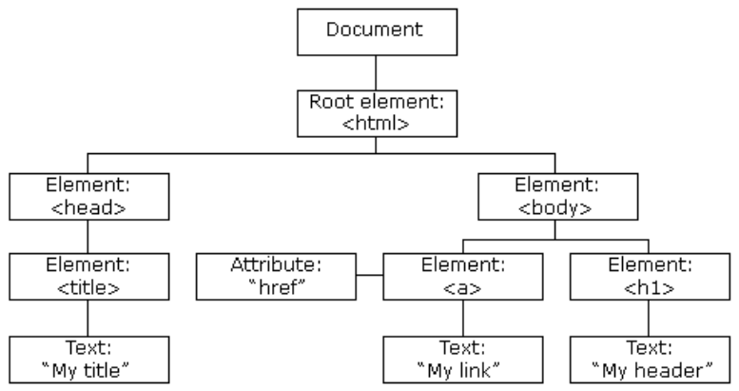
DOM Selectors
Document :
It all starts with the document, the root node

Slide 84
DOM Selectors
Exercise :
Open up the JS console and try these 4 lines:
document.URL;
document.head;
document.body;
document.links;

Slide 85
DOM Selectors
Methods :
The document comes with a bunch of methods for selecting elements. We're going to learn about the following 5:
document.getElementById()
document.getElementsByClassName()
document.getElementsByTagName()
document.querySelector()
document.querySelectorAll()

Slide 86
DOM Selectors
GetElementById:
Takes a string argument and returns the one
element with a matching ID
var tag = document.getElementById("highlight");
<body>
<h1>Hello</h1>
<h1>Goodbye</h1>
<ul>
<li id="highlight">List Item 1</li>
<li class="bolded">List Item 2</li>
<li class="bolded">List Item 3</li>
</ul>
</body>

Slide 87
DOM Selectors
GetElementsByClassName :
Takes a string argument and returns the one element with a matching class
var tags = document.getElementsByClassName("bolded"); console.log(tags[0]);
<body>
<h1>Hello</h1>
<h1>Goodbye</h1>
<ul>
<li id="highlight">List Item 1</li>
<li class="bolded">List Item 2</li>
<li class="bolded">List Item 3</li>
</ul>
</body>

Slide 88
DOM Selectors
getElementsByTagName
Returns a list of all elements of a given tag name, like <li> or <h1>
var tags = document.getElementsByTagName("li");console.log(tags[0]);
<body>
<h1>Hello</h1>
<h1>Goodbye</h1>
<ul>
<li id="highlight">List Item 1</li>
<li class="bolded">List Item 2</li>
<li class="bolded">List Item 3</li>
</ul>
</body>

Slide 89
DOM Selectors
getElementsByTagName
Returns a list of all elements of a given tag name, like <li> or <h1>
var tags = document.getElementsByTagName("h1");console.log(tags[0]);
<body>
<h1>Hello</h1>
<h1>Goodbye</h1>
<ul>
<li id="highlight">List Item 1</li>
<li class="bolded">List Item 2</li>
<li class="bolded">List Item 3</li>
</ul>
</body>

Slide 90
DOM Selectors
querySelector
Returns the first element that matches a given CSS-style selector
//select by ID
var tag = document.querySelector("#highlight");
<body>
<h1>Hello</h1>
<h1>Goodbye</h1>
<ul>
<li id="highlight">List Item 1</li>
<li class="bolded">List Item 2</li>
<li class="bolded">List Item 3</li>
</ul>
</body>

Slide 91
DOM Selectors
querySelector
Returns the first element that matches a given CSS-style selector
//select by Class
var tag = document.querySelector(".bolded");
<body>
<h1>Hello</h1>
<h1>Goodbye</h1>
<ul>
<li id="highlight">List Item 1</li>
<li class="bolded">List Item 2</li>
<li class="bolded">List Item 3</li>
</ul>
</body>

Slide 92
DOM Selectors
querySelector
Returns the first element that matches a given CSS-style selector
//select by tag
var tag = document.querySelector("h1");
<body>
<h1>Hello</h1>
<h1>Goodbye</h1>
<ul>
<li id="highlight">List Item 1</li>
<li class="bolded">List Item 2</li>
<li class="bolded">List Item 3</li>
</ul>
</body>

Slide 93
DOM Selectors
querySelectorAll
Returns a list of elements that matches a given CSS-style selector
//select by tag
var tags = document.querySelectorAll("h1");
<body>
<h1>Hello</h1>
<h1>Goodbye</h1>
<ul>
<li id="highlight">List Item 1</li>
<li class="bolded">List Item 2</li>
<li class="bolded">List Item 3</li>
</ul>
</body>

Slide 94
DOM Selectors
querySelectorAll
Returns a list of elements that matches a given CSS-style selector
//select by class
var tags = document.querySelectorAll(".bolded");
<body>
<h1>Hello</h1>
<h1>Goodbye</h1>
<ul>
<li id="highlight">List Item 1</li>
<li class="bolded">List Item 2</li>
<li class="bolded">List Item 3</li>
</ul>
</body>

Slide 95
DOM Selectors
Exercise :
Come up with 4 different ways to select the first <p> tag
<!DOCTYPE html>
<html>
<head>
<title>My title</title>
</head>
<body>
<h1>I am an h1!</h1>
<p id="first" class="special">Hello</p>
<p class="special">Goodbye</p>
<p>Hi Again</p>
<p id="last">Goodbye Again</p>
</body>
</html>

Slide 96
DOM Manipulation
We're going to cover different ways of:
changing an element's style
adding/removing classes
changing the content of a tag
changing attributes(src, href, etc.)

Slide 97
DOM Manipulation
Style:
The style property is one way to manipulate an element's style
//SELECT
var tag = document.getElementById("highlight");
//MANIPULATE
tag.style.color = "blue";
tag.style.border = "10px solid red";
tag.style.fontSize = "70px";
tag.style.background = "yellow";
tag.style.marginTop = "200px";

Slide 98
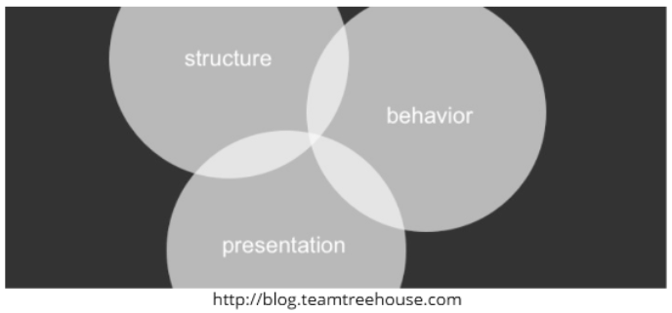
DOM Manipulation
Is This a Bad Idea?
It is recommended for styles to be defined in a separate file or files. The style property allows for quick styling, for example for testing purposes. - MDN
Separation of Concerns

Slide 99
DOM Manipulation
An Alterative
Rather than directly manipulating style with JS, we can define a CSS class and then toggle it on or off with JS
//INSTEAD OF THIS:
var tag = document.getElementById("highlight");
tag.style.color = "blue";
tag.style.border = "10px solid red";
/*DEFINE A CLASS IN CSS*/
.some-class {
color: blue;
border: 10px solid red;
}
var tag = document.getElementById("highlight");
//ADD THE NEW CLASS TO THE SELECTED ELEMENT
tag.classList.add("some-class");

Slide 100
DOM Manipulation
classList
A read-only list that contains the classes for a given element. It is not an array.
/*DEFINE A CLASS IN CSS*/
.another-class {
color: purple;
fontSize: 76px;
}
var tag = document.querySelector("h1");
//ADD A CLASS TO THE SELECTED ELEMENT
tag.classList.add("another-class");
//REMOVE A CLASS
tag.classList.remove("another-class");
//TOGGLE A CLASS
tag.classList.toggle("another-class");

Slide 101
DOM Manipulation
TextContent:
Returns a string of all the text contained in a given element
<p>
This is an <strong>awesome</strong> paragraph
</p>
//Select the <p> tag:
var tag = document.querySelector("p");
//Retrieve the textContent:
tag.textContent //"This is an awesome paragraph"
//alter the textContent:
tag.textContent = "blah blah blah";

Slide 102
DOM Manipulation
innerHTML:
Similar to textContent, except it returns a string of all the HTML contained in a given element
<p>
This is an <strong>awesome</strong> paragraph
</p>
//Select the <p>tag:
var tag = document.querySelector("p");
tag.innerHTML //"This is an <strong>awesome</strong> paragraph"

Slide 103
DOM Manipulation
Attributes
Use getAttribute() and setAttribute() to read and write attributes like src or href
<a href="www.google.com">I am a link</a>
<img src="logo.png">
var link = document.querySelector("a");
link.getAttribute("href");
link.setAttribute("href","www.dogs.com");
var img = document.querySelector("img");
img.setAttribute("src", "corgi.png");

Slide 104
DOM Events
Making things interactive
Events are everywhere
Clicking on a button
Hovering over a link
Dragging and Dropping
Pressing the Enter key

Slide 105
DOM Events
Making things interactive
The Process :
We select an element and then add an event listener
"Listen for a click on this <button>"
"Listen for a hover event on the <h1>"
"Listen for a keypress event on text input"

Slide 106
DOM Events
Making things interactive
The Syntax :
To add a listener, we use a method called addEventListener
element.addEventListener(type, functionToCall);
var button = document.querySelector("button");
button.addEventListener("click", function() {
console.log("SOMEONE CLICKED THE BUTTON!");
})

Slide 107
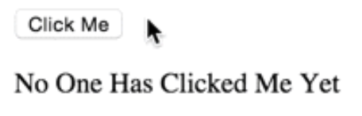
DOM Events
Making things interactive
An Example :
Let's display a message when a button is clicked
<button>Click Me</button>
<p>No One Has Clicked Me Yet</p>
var button = document.querySelector("button");
var paragraph = document.querySelector("p");
//SETUP CLICK LISTENER
button.addEventListener("click", function() {
paragraph.textContent = "Someone Clicked the Button!";
});

Slide 108
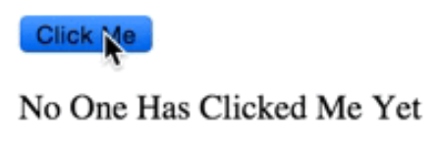
DOM Events
Making things interactive
An Example :
Let's display a message when a button is clicked
<button>Click Me</button>
<p>No One Has Clicked Me Yet</p>
var button = document.querySelector("button");
var paragraph = document.querySelector("p");
//SETUP CLICK LISTENER
button.addEventListener("click", function() {
paragraph.textContent = "Someone Clicked the Button!";
});

Slide 109
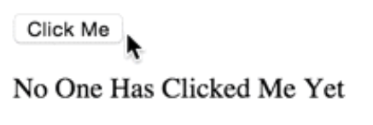
DOM Events
Making things interactive
An Example :
We could also rewrite it using a named function
var button = document.querySelector("button");
var paragraph = document.querySelector("p");
button.addEventListener("click", changeText);
function changeText() {
paragraph.textContent = "Someone Clicked the Button!";
}

Slide 110
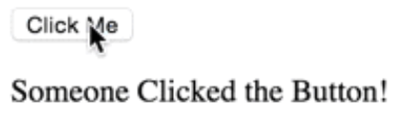
DOM Events
Making things interactive
An Example :
We could also rewrite it using a named function
var button = document.querySelector("button");
var paragraph = document.querySelector("p");
button.addEventListener("click", changeText);
function changeText() {
paragraph.textContent = "Someone Clicked the Button!";
}

Slide 111
DOM Events
Making things interactive
So Many Events! :
MDN lists over 300 different events! Here are some of the more common ones:
click
mouseover
dblclick
keypress
drag

Slide 112
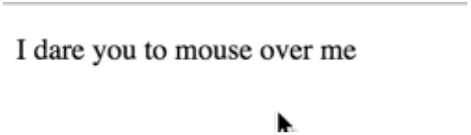
DOM Events
Making things interactive
Another Example :
Let's try a quick example using mouseOver
<p>
I dare you to mouse over me
</p>
var paragraph = document.querySelector("p");
//SETUP MOUSE OVER LISTENER paragraph.addEventListener("mouseover", function() {
paragraph.textContent = "Stop hovering over me!";
});

Slide 113
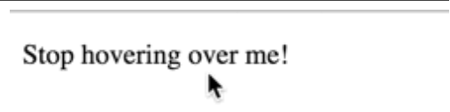
DOM Events
Making things interactive
Another Example :
Let's try a quick example using mouseOver
<p>
I dare you to mouse over me
</p>
var paragraph = document.querySelector("p");
//SETUP MOUSE OVER LISTENER paragraph.addEventListener("mouseover", function() {
paragraph.textContent = "Stop hovering over me!";
});

Slide 114
DOM Events
Making things interactive
Adding mouseout :
Let's use mouseout so that our message changes back when the user is done hovering
var paragraph = document.querySelector("p");
//SETUP MOUSE OVER LISTENER
paragraph.addEventListener("mouseover", function() {
paragraph.textContent = "Stop hovering over me!";
}); //SETUP MOUSE OUT LISTENER
paragraph.addEventListener("mouseout", function() {
paragraph.textContent = "Phew, thank you for leaving me alone";
});

Slide 115
DOM Events
Making things interactive
Adding mouseout :
Let's use mouseout so that our message changes back when the user is done hovering
var paragraph = document.querySelector("p");
//SETUP MOUSE OVER LISTENER
paragraph.addEventListener("mouseover", function() {
paragraph.textContent = "Stop hovering over me!";
}); //SETUP MOUSE OUT LISTENER
paragraph.addEventListener("mouseout", function() {
paragraph.textContent = "Phew, thank you for leaving me alone";
});

Slide 116
DOM Events
Making things interactive
A Minor Change :
We can DRY up our code with one small change:
var paragraph = document.querySelector("p");
//SETUP MOUSE OVER LISTENER
paragraph.addEventListener("mouseover", function() {
this.textContent = "Stop hovering over me!";
});
//SETUP MOUSE OUT LISTENER
paragraph.addEventListener("mouseout", function() {
this.textContent = "Phew, thank you for leaving me alone";
});

Slide 117
DOM Events
Making things interactive
A Minor Change :
We can DRY up our code with one small change:
var paragraph = document.querySelector("p");
//SETUP MOUSE OVER LISTENER
paragraph.addEventListener("mouseover", function() {
this.textContent = "Stop hovering over me!";
});
//SETUP MOUSE OUT LISTENER
paragraph.addEventListener("mouseout", function() {
this.textContent = "Phew, thank you for leaving me alone";
});

Slide 118
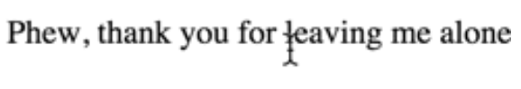
DOM Events
Making things interactive
A Minor Change :
We can DRY up our code with one small change:
var paragraph = document.querySelector("p");
//SETUP MOUSE OVER LISTENER
paragraph.addEventListener("mouseover", function() {
this.textContent = "Stop hovering over me!";
});
//SETUP MOUSE OUT LISTENER
paragraph.addEventListener("mouseout", function() {
this.textContent = "Phew, thank you for leaving me alone";
});

Slide 119

What is jQuery?
jQuery is a DOM manipulation library

Slide 120
What is jQuery?
It comes with a bunch of useful methods to things like:
Select Elements
Manipulate Elements
Create Elements
Add Event Listeners
Animate Elements
Add Effects
Make HTTP Requests(AJAX)

Slide 121
Why Use jQuery?
Fixes "broken" DOM API
Brevity and Clarity
Ease of use
Cross-Browser Support
AJAX
Lot's of people use jQuery!

Slide 122
jQuery
Adding jQuery :
Download jQuery and link to it locally:
<script type="text/javascript" src="jquery.js"></script>
OR
Link to a CDN(a hosted copy)
<script type="text/javascript" src="https://code.jquery.com/jquery-2.1.4.js"></script>

Slide 123
jQuery
Quick Preview :
Here's a 30 second preview of what jQuery looks like:
//when a user clicks the button with id 'trigger'
$('#trigger').click(function(){
//change the body's background to yellow
$('body').css("background", "yellow");
//fade out all img's over 3 seconds
$('img').fadeOut(3000, function() {
//remove imgs from page when fadeOut is done
$(this).remove();
});
});

Slide 124
jQuery Selectors
Objectives
Select elements with $()
Use .css() to style elements

Slide 125
Selecting with jQuery
$("selectorGoesHere")
Selecting with jQuery is very similar to querySelectorAll, in that we provide a CSS style selector and jQuery will return all matching elements

Slide 126
Selecting with jQuery
$("selectorGoesHere")
We select and then manipulate
//to select all img tags
$("img")
//to select all elements with class 'sale' $(".sale")
//to select element with id "bonus"
$("#bonus")
//to select all a tags inside of li's
$("li a")

Slide 127
jQuery
Manipulating Style
The .css() method is jQuery's interface to styling.
$(selector)
.css(property, value)

Slide 128
jQuery
Manipulating Style .css(property, value)
We select and then manipulate
//select elem with id "special" and give it a border
$("#special").css("border", "2px solid red");
//we can also pass in an object with styles
var styles = {
backgroundColor : "pink",
fontWeight: "bold"
};
$("#special").css(styles);

Slide 129
jQuery
Manipulating Style .css(property, value)
We can style multiple elements at once
//select all li's and make them yellow
$("li").css("color", "yellow");
//select all elements with class "big"
//and give them an orange border
$(".big").css("border", "1px dashed orange");

Slide 130
jQuery
Exercise :
Use the following starter HTML:
<div>Div 1</div>
<div class="highlight">Div 2</div>
<div id="third">Div 3</div>
<div class="highlight">Div 4</div>
Correctly include jQuery
Select all divs and give them a purple background
Select the divs with class "highlight" and make them 200px wide
Select the div with id "third" and give it a orange border
Bonus: Select the first div only and change its font color to pink

Slide 131
Common jQuery Methods

Slide 132
jQuery
Common methods:
val()
text()
attr()
html()
addClass()
removeClass()
toggleClass()

Slide 133
jQuery Events
Making things Interactive

Slide 134
jQuery Events
Objectives :
click()
keypress()
on()

Slide 135
jQuery Events
Click()
jQuery's click() method is a quick and easy way to add a click listener to element(s)
//prints when item with id 'submit' is clicked
$('#submit').click(function(){
console.log("Another click");
});
//alerts when ANY button is clicked
$('button').click(function(){
alert("Someone clicked a button");
});

Slide 136
jQuery Events
keypress()
jQuery's keypress() method is a quick and easy way to add a keypress listener to element(s)
//listen for any keypress in any text input
$('input[type="text"').keypress(function(){
alert("text input keypress!");
});

Slide 137
jQuery Events
on()
jQuery's on() works similarly to addEventListener It lets you specify the type of event to listen for.
//prints when item with id 'submit' is clicked
$('#submit').on('click', function(){
console.log("Another click");
});
//alerts when ANY button is clicked
$('button').on('click', function(){
console.log("button clicked!");
});

Slide 138
jQuery Events
on()
It's not just for click events. on() supports all types of events
//double click event
$('button').on('dblclick', function(){
alert("DOUBLE CLICKED!");
});
//drag start event
$('a').on('dragstart', function(){
console.log("DRAG STARTED!");
});
//keypress event
$('input[type="text"').on('keypress', function(){
alert("key press in an input!")
});

Slide 139
jQuery Events
Why Use On()?
In most cases, click() and on('click') will both get the job done. HOWEVER, there is one key difference:
click() only adds listeners for existing elements
on() will add listeners for all potential future elements
This will all make sense in the next video!

Slide 140
ES6

Slide 141
ES6
JavaScript History
1995 - JavaScript Created
1997 - ECMAScript 1
2009 - ECMAScript 5
2015 - ECMAScript 6

Slide 142
ES6
Why we need to use ES6?
Better features
Compatible with latest libraries
Improved performance

Slide 143
ES6 Features
let keyword​
const keyword​
Iterator & for-of​
template literals​
spread operator​
classes
class inheritance
Default function parameters​
Enhanced object literals​
Arrow Functions​
Arrow Functions and 'this' scope​
Destructuring assignment​
generators
promises

Slide 144
ES6
let keyword
let allows you to declare variables that are limited in scope to the block, statement, or expression on which it is used.

Slide 145
ES6
let keyword
function varTest() {
var x = 1;
if (true) {
var x = 2; // same variable!
console.log(x); // 2
}
console.log(x); // 2
}
function letTest() {
let x = 1;
if (true) {
let x = 2; // different variable
console.log(x); // 2
}
console.log(x); // 1
}

Slide 146
ES6
Default parameters
Default function parameters allow formal parameters to be initialized with default values if no value or undefined is passed.
//ES5
var getAccounts = function(limit) {
var limit = limit || 10 // ...
}
var link = function (height, color, url) {
var height = height || 50
var color = color || 'red'
var url = url || 'https://node.university'
// ...
}

Slide 147
ES6
Default parameters
Default function parameters allow formal parameters to be initialized with default values if no value or undefined is passed.
/* ES6, we can put the default values right in the
signature of the functions like below */
const getAccounts = function(limit = 10) {
//...
}
const link = function(height = 50,
color = 'red',
url = 'https://node.university') {
//...
}

Slide 148
ES6
const keyword
Constants are block-scoped, much like variables defined using the let statement. The value of a constant cannot change through re-assignment, and it can't be redeclared.
const PI = 3.14;
PI=2.4 //TypeError: Assignment to constant variable.

Slide 149
Lab

Slide 150
MongoDB

Slide 151
MongoDB
About
Commands
Features
use
show dbs
show collections
insert/save
find()
_id
updateOne
remove
deleteOne
aggregate
indexing
replicaSet
sharding
mongodump
mongorestore
History
How to install?
“No SQL” concept
Where Mongo Fits in
MongoShell
Robo3T (formerly RoboMongo)

Slide 152
History

Slide 153
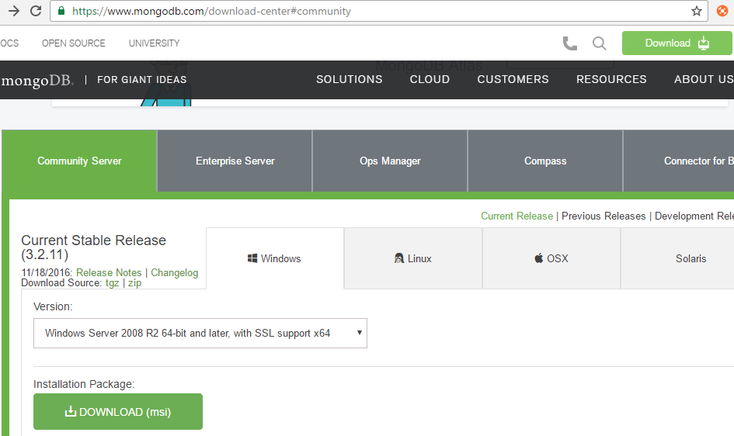
How to install?
https://www.mongodb.com/download-center#community​

Slide 154
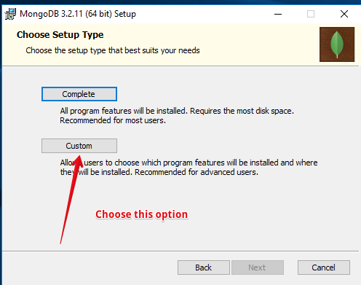
How to install?

Slide 155
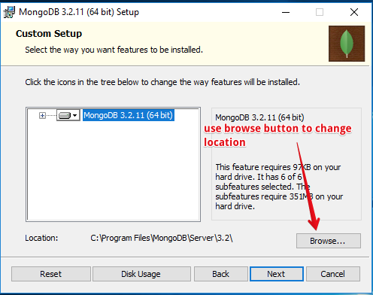
How to install?

Slide 156
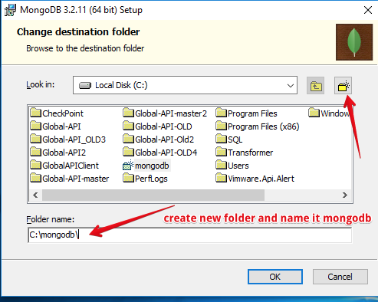
How to install?

Slide 157
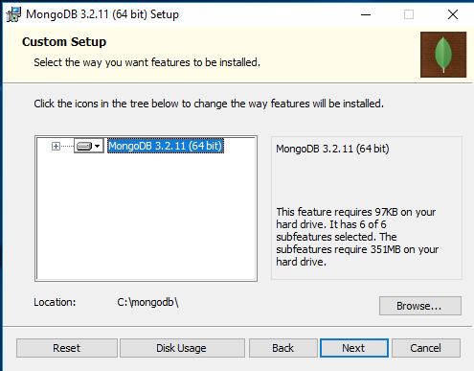
How to install?

Slide 158
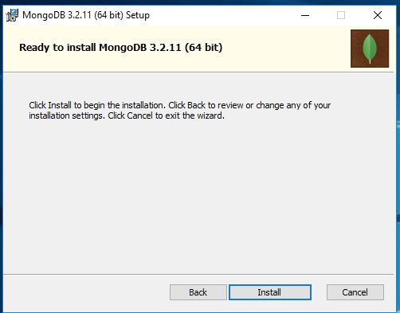
How to install?

Slide 159
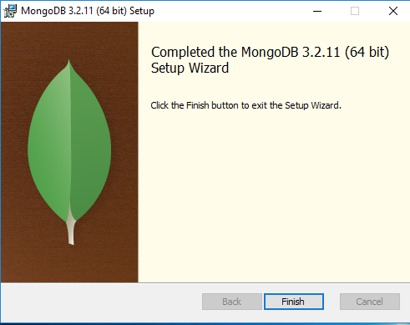
How to install?

Slide 160
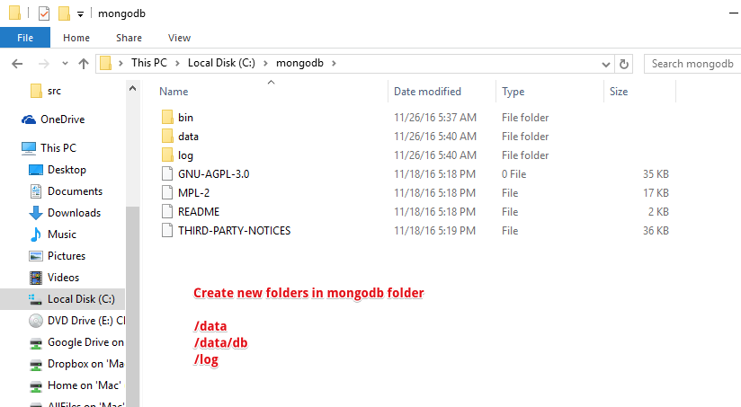
How to install?

Slide 161
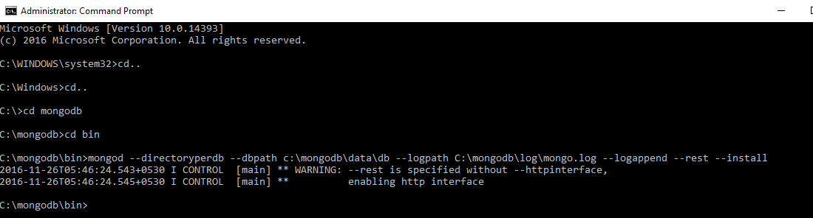
How to install?

Slide 162
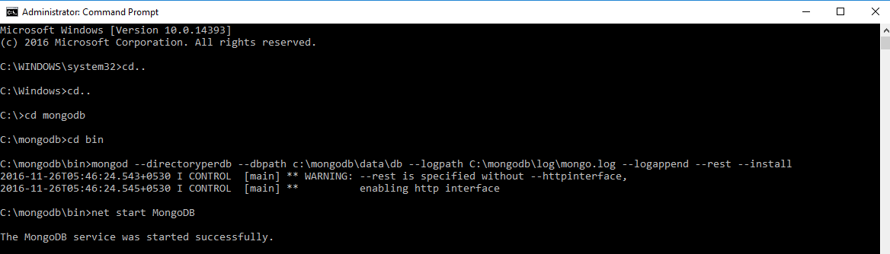
How to install?

Slide 163
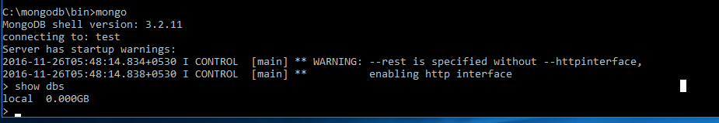
How to install?

Slide 164
“No SQL” concept
Relational database management systems are transaction-based and have ACID
rules. NoSQL systems do not fully support the ACID rules and there is no
transaction concept in many NoSQL systems.
Data in the relational database management systems is located on fixed tables
and columns. NoSQL systems are not dependent on fixed tables and columns.
SQL query is not used in NoSQL systems.
Disintegration of data by primary key is not compulsory in relational database
management systems. NoSQL systems access the data over primary keys.

Slide 165
MongoDB vs SQL
database | database
table | collection
row | document or BSON document
column | field
index | index
table joins | embedded documents and linking
primary key Specify any unique column or column combination as primary key. | primary key In MongoDB, the primary key is automatically set to the _id field.
aggregation (e.g. group by) | aggregation framework See the SQL to Aggregation Framework Mapping Chart.

Slide 166
Where Mongo Fits in

Slide 167
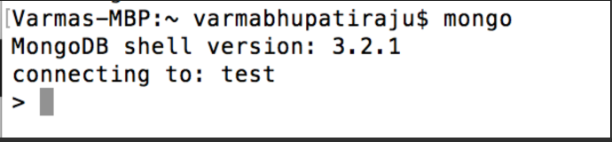
MongoShell
$mongo

Slide 168
MongoShell
Runs JavaScript
Run Administrative tasks​
Run single adhoc command​
Useful for
Administrative tasks
Batch Processing
Fixing/Modifying some documents

Slide 169
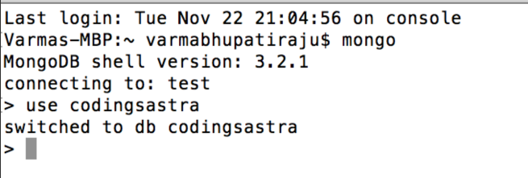
MongoShell
Switch to another database or create new database
> use codingsastra

Slide 170
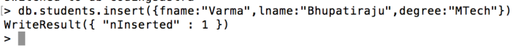
MongoShell
Create collection by creating new document in the collection
>db.students.insert({fname:"Varma",lname:"Bhupatiraju",degree:"MTech"});

Slide 171
MongoShell
Create collection by creating new document in the collection
>db.students.insert({fname:"Basanth",lname:"Alluri",degree:"MTech",gender:”Male”,age:22});
What did you observe from previous insert?

Slide 172
MongoShell
Find records in collection using find function
>db.students.find({});

Slide 173
MongoShell
You can insert more than one record at a time by using db.students.insertMany([{...},{..}])

Slide 174
MongoShell
Find specific records in collection using find function with arguments
>db.students.find({fname:”Varma”});

Slide 175
MongoShell
Return the Specified Fields and the _id Field Only
>db.students.find({},{fname:1,lname:1});

Slide 176
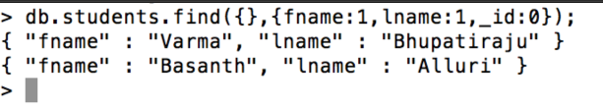
MongoShell
Return the Specified Fields without the _id Field
>db.students.find({},{fname:1,lname:1,_id:0});

Slide 177
MongoShell
Update specific document to update fields
>db.students.updateOne({fname:"Varma"},{ $set: {"degree":"BTech"}});

Slide 178
MongoShell
delete specific document
>db.students.remove({fname:"Varma"});
>db.students.deleteOne({fname:"Varma"});//added in 3.2
Other delete methods available
>db.students.deleteMany({gender:"Male"});//added in 3.2

Slide 179
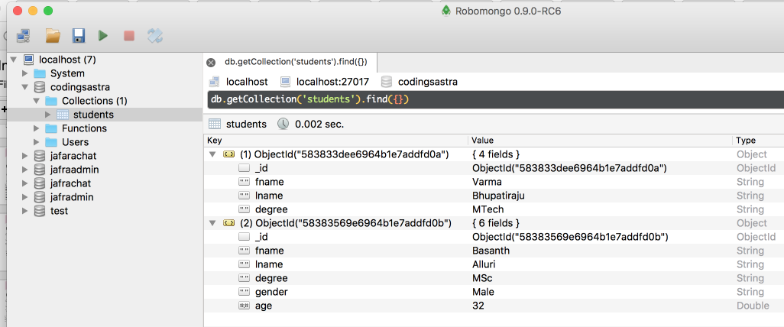
Robo3T (formerly RoboMongo)

Slide 180
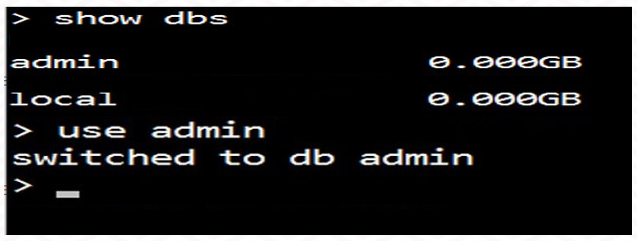
use
You must run some commands on the admin database. Normally, these operations resemble the followings:

Slide 181
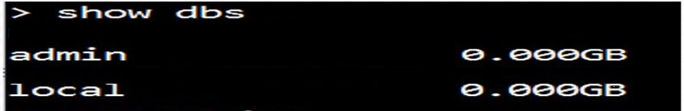
show dbs
If you want to check your databases list, use the command show dbs.

Slide 182
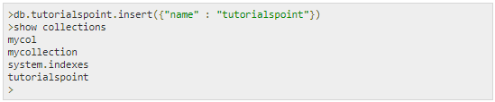
show collections
In MongoDB, you don't need to create collection. MongoDB creates
collection automatically, when you insert some document.

Slide 183
find()
Find records in collection using find function
>db.students.find();

Slide 184
_id
Return the Specified Fields without the _id Field​

Slide 185
updateOne
Update specific document to update fields
>db.students.updateOne({fname:"Varma"},{ $set: {"degree":"BTech"}});

Slide 186
remove

Slide 187
deleteOne

Slide 188
aggregate

Slide 189
indexing

Slide 190
replicaSet

Slide 191
sharding

Slide 192
mongodump

Slide 193
mongorestore

Slide 194
Lab

Slide 195
Node JS

Slide 196
Node JS
Express
Node Init
Mongoose
What is express?
basic route
http methods
route paths
route parameters
response methods
middleware Functions
body-parser
Chrome Postman
History
What is Node?
Node architecture
Npm
Node advantages
Use Cases
What is mongoose?
Schema
Model
Querying
Save/update/remove

Slide 197
History

Slide 198
What is Node?
Node.js is an open-source
cross-platform runtime environment for running server-side Web applications.
It is C++ program built on top of Google's Chrome V8 engine.
V8 is Google's open source high-performance JavaScript engine, written in C++ and used in Google Chrome, the open source browser from Google.
Ryan Dahl, Developer from Joyent, initially created Node.js on top of Google V8 capabilities.

Slide 199
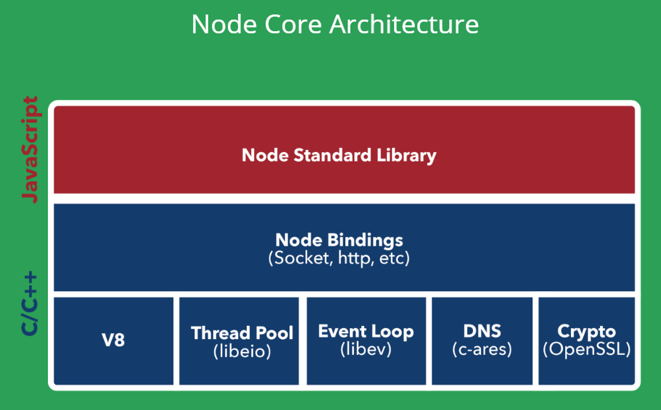
Node architecture

Slide 200
Npm
Use npm to install, share, and distribute code; manage
dependencies in your projects; and share & receive feedback
NPM is a package manager for Node.js packages, or modules if you
like.
www.npmjs.com hosts thousands of free packages to download and
use.
The NPM program is installed on your computer when you install
Node.js

Slide 201
Node advantages
1. The Fast Suite
2. Go With Data Streaming
3. Present Everywhere
4. Real-Time Web Applications
5. Solves All Database Queries
6. Easy On Coding
7. Dynamic NPM
8. In Charge With Proxy Server
9. Rise In Productivity
10. The Hosting Deal
11. Good With Sync Issues
12. Community Friendly

Slide 202
Use Cases

Slide 203
express js
Fast, Unopinionated, Minimalist Web Framework for Node.js

Slide 204
What is express?
Express is a minimal and flexible Node.js web application framework that provides a robust set of features for web and mobile applications.
It is an open source framework developed and maintained by the Node.js foundation.

Slide 205
express js
Node HTTP
//contents of index.js
const http = require('http')
const port = 3000
const requestHandler = (request, response) => {
console.log(request.url)
response.end('Hello Node.js Server!')
}
const server = http.createServer(requestHandler)
server.listen(port, (err) => {
if (err) {
return console.log('something bad happened', err)
}
console.log(`server is listening on ${port}`)
})
Node's built in module 'http' allow you run basic http server
The http module is very low-level - creating a complex web application using the snippet above is very time-consuming.
This is the reason why we need expressjs

Slide 206
express js
A routing & sugar layer on top of Node HTTP Server
Declarative routing
Basic middleware pattern

Slide 207
express js
Routing
Definition of application end points and how they
respond to client requests

Slide 208
express js
Basic Route
var express = require('express')
var app = express()
app.get('/', function (req, res) {
res.send('Hello World!')
})
app.listen(3000)

Slide 209
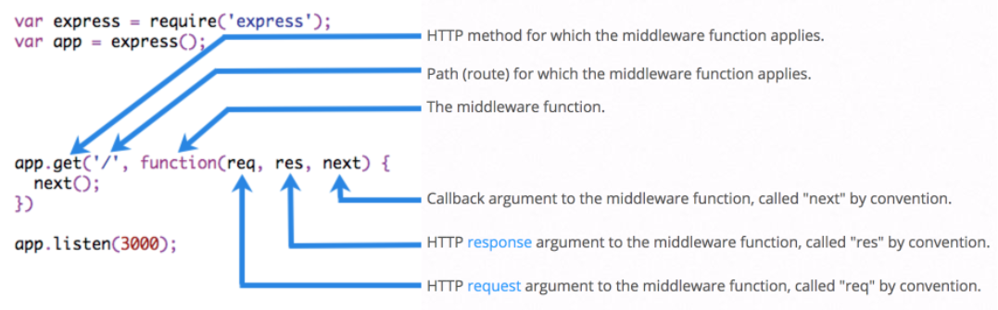
express js
Basic Route

Slide 210
express js
Route Definition
app.METHOD(PATH, HANDLER)
app is an instance of express
METHOD is am HTTP request method in lowercase
PATH is a path on server
HANDLER is the function executed when route is matched

Slide 211
express js
Sample Route Defintions
app.get("/", function(req, res)
{
//--
});
app.post("/", function(req, res)
{
//--
});
app.put("/", function(req, res)
{
//--
});
app.delete("/", function(req, res)
{
//--
});

Slide 212
express js
Sample Route Defintions
app.get("/", function(req, res)
{
//--
});
app.post("/", function(req, res)
{
//--
});
app.put("/", function(req, res)
{
//--
});
app.delete("/", function(req, res)
{
//--
});
<= GET http://localhost:3000/
<= POST http://localhost:3000/
<= PUT http://localhost:3000/
<= DELETE http://localhost:3000/

Slide 213
express js
Supported Route Methods
get
post
put
delete
options​
head​
trace​
copy​
more..
special routing method - all
app.all("/secret", function(req,res,next){
//...
//pass control to next handler next();
});

Slide 214
express js
Route Path
In combination with request method, Route path define the
end points at which requests can be made
strings, string patterns and regular expressions are allowed in paths
'/'
'/abcd'
'/ab?cd'
//match acd, abcd
'/ab*cd'
//match abcd, abbcd, abbbcd and so on..

Slide 215
express js
Route Parameters
Named URL segments are used to capture values specified
at position of URL
Captured values are available in req.params object
app.get('/users/:userid/books/:bookid', function(req, res, next) {
var userid = req.params.userid;
var bookid = req.params.bookid;
// ---
});

Slide 216
express js
Route Handlers
Handler is a callback function to handle the request. You
can provide multiple callback functions for single request.
app.get('/', function(req, res, next) {
// ---
next();
},
function(req,res,next)
{
// --
} );

Slide 217
express js
Route Handlers
Array of Callback functions can be supplied
var cb1 = function(req,res,nex)
{ //-- next(); }
var cb2 = function(req,res,nex)
{ //-- next(); }
var cb3 = function(req,res,nex)
{ //-- next(); }
app.get('/', [cb1,cb2,cb3]);
//User signup
app.get('/users'[saveUser,sendWelcomeLetter,addUserToMailchimp]);

Slide 218
express js
Response Methods
Response method send response to client and end the
request-response cycle.Otherwise, client request will left hanging
app.get('/', function(req,res,next) {
res.send('Send this to client and end');
});
Combination of individual and array of functions allowed

Slide 219
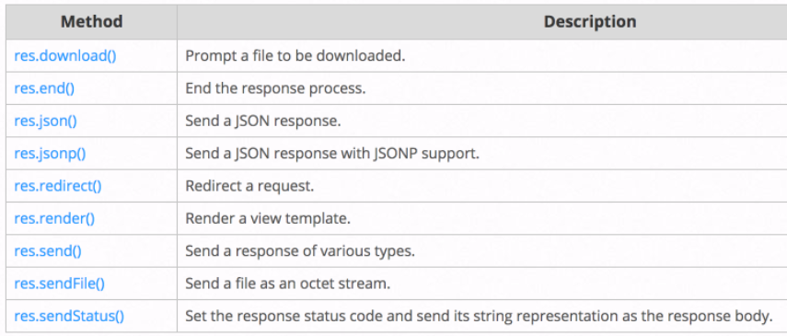
express js
Response Methods
Response method send response to client and end the request-response cycle.
Otherwise, client request will left hanging
app.get('/', function(req,res,next) {
res.send('Send this to client and end');
});

Slide 220
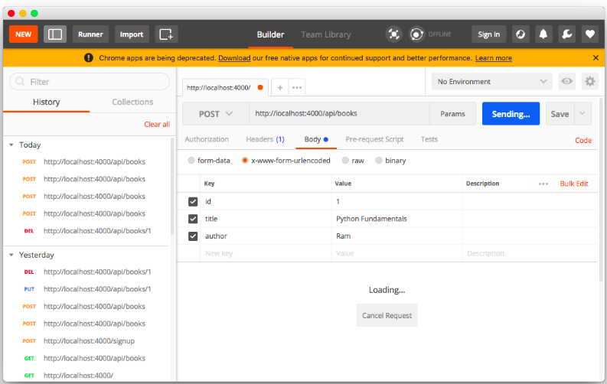
express js
Node API Testing
Chrome Postman
Install Postman chrome plugin from Chrome Webstore

Slide 221
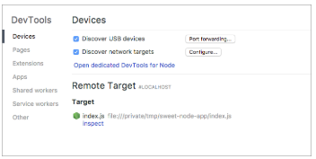
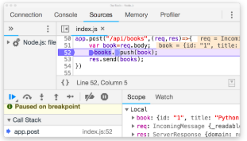
express js
Node Debugging
Steps to debug:
Run node with the --inspect flag:
$ node --inspect index.js
Open about:inspect in Chrome
It’ll redirect you to chrome://inspect quickly and you’ll see something like:
Click the Open dedicated DevTools for Node link
You’ll get a popup window for debugging your node session.

Slide 222
express js
app.route()
You can create chainable route handlers for a route path by using app.route().
app.get('/book', function (req, res) {
res.send('Get a random book')
});
app.post('/book', function (req, res) {
res.send('Add a book')
});
app.put('/book', function (req, res) {
res.send('Update the book')
})

Slide 223
express js
app.route()
You can create chainable route handlers for a route path by using app.route().
app.route('/book') .get(function (req, res) {
res.send('Get a random book')
})
.post(function (req, res) {
res.send('Add a book')
})
.put(function (req, res) {
res.send('Update the book')
})

Slide 224
express js
express.Router()
Use the express.Router class to create modular, mountable route handlers. A Router
instance is a complete middleware and routing system
//books.js var express = require('express')
var router = express.Router()
// define the home page route
router.get('/', function (req, res) {
res.send('Books')
}) // define the about route
router.get('/:id', function (req, res) {
res.send('Single book')
})
module.exports = router;
//users.js var express = require('express')
var router = express.Router()
// define the home page route
router.get('/', function (req, res) {
res.send('Users') })
// define the about route
router.get('/:id', function (req, res) {
res.send('Single user')
})
module.exports = router;
//Server.js
var books = require('./books')
var users = require('./users')
// ...
app.use('/books', books)
app.use('/users', users)

Slide 225
HTTP Methods

Slide 226
Middleware Functions

Slide 227
body-parser

Slide 228
What is mongoose?

Slide 229
Schema

Slide 230
Model

Slide 231
Querying

Slide 232
Save/update/remove

Slide 233
Lab

Slide 234
React

Slide 235
React
Intro
Life Cycle
Demo
History
What is React
Component
State
Props
JSX
Virtual DOM
constructor
render
this.setState
synthetic events
life cycle methods
create-react-app
SPA
ReactDOM.render
live reloading
fetch API
parent-to-child
child-to-parent

Slide 236
History

Slide 237
What is React
Developed by Facebook
React is a view layer library, not a framework like Backbone, Angular etc.
You can't use React to build a fully-functional web app

Slide 238
Why was React developed?
Complexity of two-way data binding
Bad UX from using "cascading updates" of DOM tree
A lot of data on a page changing over time
Complexity of Facebook's UI architecture
Shift from MVC mentality

Slide 239
Why was React developed?
Easy to read and understand views
Concept of components is the future of web development
If your page uses a lot of fast updating data or real time
data - React is the way to go
Once you and your team is over the React's learning
curve, developing your app will become a lot faster

Slide 240
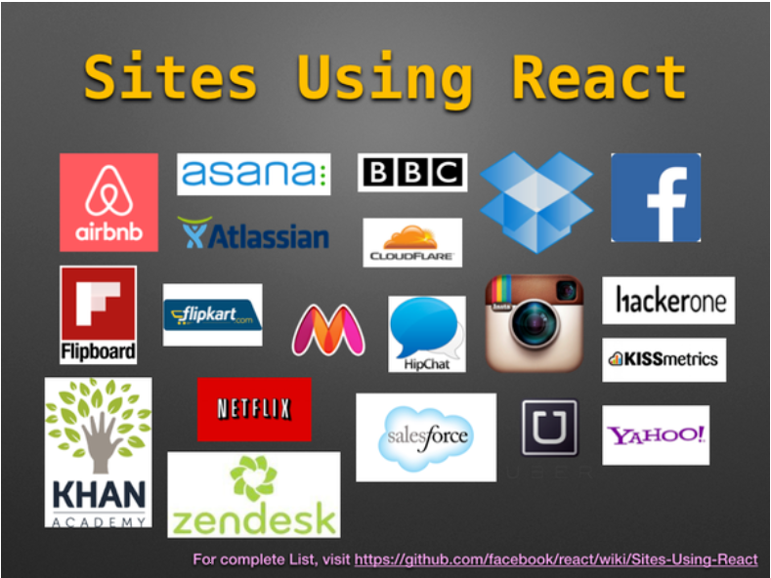
What sites using react?

Slide 241
How to know if site using react?
React-Detector chrome plugin
https://chrome.google.com/webstore/detail/react-detector/jaaklebbenondhkanegppccanebkdjlh
This plugin allow you to find whether react being used in the website or not.
https://github.com/facebook/react/wiki/sites-using-react

Slide 242
Setup React Environment
In order to setup environment, we need to use create-react-app npm package to start new react app project
Install create-react-app
$ npm install -g create-react-app
Create new react project "helloworld"
$ create-react-app helloworld
Run npm start to run helloworld react app
$ cd helloworld && npm start

Slide 243
Setup Full Stack Environment
In order to setup full stack environment, we need to use concurrently
npm package to start both Node and React's Webpack server to auto
reload both applications on file changes.
DEMO

Slide 244
Basic Component
import React, { Component } from 'react';
class App extends Component {
render()
{
return <h1>Hello World</h1>
}
}

Slide 245
Set Props on Component
We can pass data into our components by using what's called props.
index.js
app.js
import React from 'react';
import ReactDOM from 'react-dom';
import App from './App';
ReactDOM.render(
<App txt="this is the prop text" />
document.getElementById('root');
);
import React from 'react';
class App extends React.Component {
render(){
return <h1>{this.props.txt}</h1> }
}
export default App

Slide 246
PropTypes
We can define the properties that we're going to be looking for in our component by adding a property to our component called PropTypes.
index.js
app.js
import React from 'react';
import ReactDOM from 'react-dom';
import App from './App';
ReactDOM.render(
<App
txt="this is the prop text"
/>
document.getElementById('root');
);
import React from 'react';
class App extends React.Component {
render(){
return <h1>{this.props.txt}</h1>
}
}
App.propTypes = {
txt: React.PropTypes.string,
cat: React.PropTypes.number
}
export default App

Slide 247
isRequired
On each of these PropTypes, we can add an isRequired to it to make sure
props are passed to component otherwise react throw error in console
index.js
app.js
import React from 'react';
import ReactDOM from 'react-dom';
import App from './App';
ReactDOM.render(
<App
txt="this is the prop text"
/>
document.getElementById('root');
);
import React from 'react';
class App extends React.Component {
render(){
return <h1>{this.props.txt}</h1>
}
}
App.propTypes = {
txt: React.PropTypes.string,
cat:React.PropTypes.number.isRequired
}
export default App

Slide 248
defaultProps
On each of these PropTypes, we can add an isRequired to it to make sure
props are passed to component otherwise react throw error in console
index.js
app.js
import React from 'react';
import ReactDOM from 'react-dom';
import App from './App';
ReactDOM.render(
<App
txt="this is the prop text"
/>
document.getElementById('root');
);
import React from 'react';
class App extends React.Component {
render(){
return <h1>{this.props.txt}</h1>
}
}
App.PropTypes = {
txt: React.PropTypes.string,
cat: React.PropTypes.number.isRequired
}
App.defaultProps = {
txt: "this is the default txt"
}
export default App

Slide 249
state
State is used for properties on a component that will change, versus static props that are passed in.
import React from 'react';
class App extends React.Component {
constructor(){
super();
this.state = {
txt: 'this is the state txt', cat: 0
}
}
update(e){
this.setState({txt: e.target.value})
}
render(){
return (
<div>
<input type="text" onChange={this.update.bind(this)}/>
<h1>{this.state.txt} - {this.state.cat}</h1>
</div> )
}
} export default App

Slide 250
Children
import React from 'react';
class App extends React.Component {
constructor(){
super();
this.state = { txt: 'this is the state txt', cat: 0 }
}
update(e){
this.setState({txt: e.target.value})
}
render(){
return ( <div>
<h1>{this.state.txt} - {this.state.cat}</h1>
<Widget update="this.update(this).bind(this)"/>
<Widget update="this.update(this).bind(this)"/>
</div> )
}
}
//Stateless functional component const Widget = (props) =>
<input type="text" onChange={props.update} />
export default App
React component
can output or
render other React
components

Slide 251
React Stateless Functional
Components
React 0.14 introduced a simpler way to define components called stateless
functional components. These components use plain JavaScript functions
Easy to write
Preferable for only UI/Presentational components
where state is not needed
Improved performance

Slide 252
React Stateless Functional Components
import React from 'react';
class HelloWorld extends React.component {
constructor(props) {
super(props);
}
sayHi(event) {
alert('Hi ${this.props.name}');
}
render() {
return(
<div>
<a href="#" onclick={this.sayHi.bind(this)}>Say Hi</a>
</div>);
}
}
HelloWorld.propsTypes = {
name: React.PropTypes.String.isRequired
};
export default HelloWorld;
import React from 'react';
const HelloWorld = ({name}) => {
const sayHi = (event) => {
alert('Hi $(name)');
};
return(
<div>
<a href='#' onclick={sayHi}>Say Hi</a>
</div>
);
};
HelloWorld.propTypes = {
name: React.PropTypes.String.isRequired
};
export default HelloWorld;

Slide 253
Access Nested Data with Reacts props.children
In order to access nested values or components in
a component, we can use props.children.
class App extends React.Component {
render(){
return <Button>I <Heart /> React</Button>
}
}
const Button = (props) =>
<button>{props.children}</button>
class Heart extends React.Component {
render(){
return
<span>♥</span>
}
}

Slide 254
Add Custom propType Validation to React Components
In addition to the types built into React.propTypes we can also define our own custom propType validator
class App extends React.Component {
render(){
return <Title text="12345678" />
}
}
const Title = (props) => <h1>Title: {props.text}</h1>
Title.propTypes = {
text(props, propName, component){
if(!(propName in props)){
return new Error(`missing ${propName}`)
}
if(props[propName].length < 6){
return new Error(`${propName} was too short`)}
}
}
export default App;

Slide 255
Reacts Synthetic Event System
class App extends React.Component {
constructor(){
super();
this.state = {currentEvent: '---'}
this.update = this.update.bind(this)
}
update(e){
this.setState({currentEvent: e.type})
}
render(){
return (
<div>
<textarea
onKeyPress={this.update} onCopy={this.update}
onCut={this.update} onPaste={this.update}
onFocus={this.update} onBlur={this.update}
onDoubleClick={this.update} onTouchStart={this.update}
onTouchMove={this.update} onTouchEnd={this.update}
cols="30" rows="10" />
<h1>{this.state.currentEvent}</h1>
</div> )
}
} export default App;
React has its own event
handling system which is
called Synthetic Events.
Synthetic Events is a cross-
browser wrapper of the
browser’s native event. It
works the same way as the
event system that you find
on browsers, the only
difference is that the same
code will work across all
browsers.

Slide 256
Understand the React Component Lifecycle Methods
class App extends React.Component {
constructor(){
super();
this.state = { val: 0 };
this.update = this.update.bind(this);
}
update(){
this.setState({val: this.state.val + 1 })
}
componentWillMount(){
console.log('mounting')
}
render(){
console.log('rendering!')
return
<button onClick={this.update}>{this.state.val}</button>
}
componentDidMount(){ console.log('mounted') }
componentWillUnmount(){ console.log('bye!') }
} export default App;
When our component
is added to the DOM,
this is called
mounting, and when
our component is
removed from the
DOM, this is called
unmounting.

Slide 257
Manage React Component State with Lifecycle Methods
class App extends React.Component {
constructor(){
super();
this.state = { val: 0 };
this.update = this.update.bind(this);
}
update(){
this.setState({val: this.state.val + 1 })
}
componentWillMount(){ console.log('mounting') }
render(){ console.log('rendering!')
return
<button onClick={this.update}>{this.state.val}</button>
}
componentDidMount(){ console.log('mounted') }
componentWillUnmount(){ console.log('bye!') }
}
export default App;
In componentWillMount,
we have access to our state and our props
but we do not have
access to the DOM
representation of our
component yet because
it has not been placed
into the DOM. In
componentDidMount,
we have access to our
component in the DOM

Slide 258
Control React Component Updates When
New Props Are Received
The React component lifecycle will allow you to update your components at runtime.
componentWillReceiveProps gives us an opportunity to update state by reacting to a prop transition before the render() call is made.
shouldComponentUpdate allows us to set conditions on when we
should update a component so that we are not rendering constantly.
componentDidUpdate lets us react to a component updating.

Slide 259
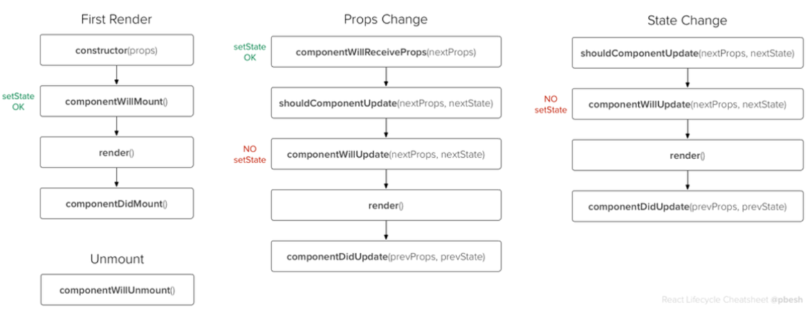
React Life Cycle Flow Chart

Slide 260
React Data Flow
Data Down
Actions Up

Slide 261
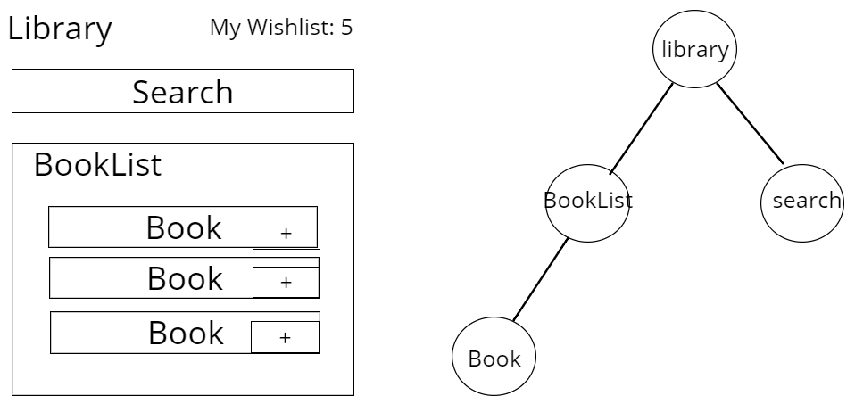
Data Flow in React
Passing data between components

Slide 262
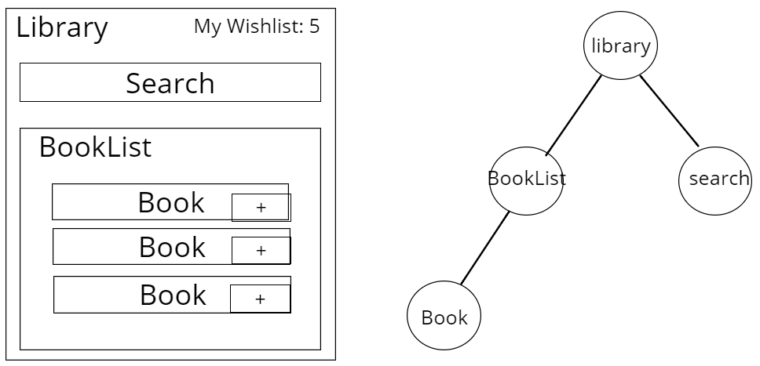
Data Flow in React
Passing data between components

Slide 263
Parent to Child — Use Prop
Library to BooksList
//.....
class Library extends Component {
//.....
this.state={ books } render(){
return (
<BookList books={this.state.books}/>
)
}
}

Slide 264
Parent to Child — Use Prop
BookList to Book
//.....
class BookList extends Component
{
//.....
this.state={ books: this.props.books }
render(){
return ( {
this.state.books.map ( (book)=>{
return <Book book={book}/>
});
} )
}
}

Slide 265
Child to Parent
Child to Parent — Use a callback and states
Define a callback in my parent which takes the data
I need in as a parameter.
Pass that callback as a prop to the child
Call the callback using this.props.[callback] in the child,
and pass in the data as the argument.

Slide 266
Virtual DOM

Slide 267
constructor

Slide 268
this.setState

Slide 269
synthetic events

Slide 270
life cycle methods

Slide 271
SPA

Slide 272
ReactDOM.render

Slide 273
live reloading

Slide 274
fetch API

Slide 275
Lab

Slide 276
Hands-On Project

Slide 277
Hands-On Project
Roommate Finder
Develop a website for users to find a roommate to share room with using React,
Node and MongoDB.
Features:
Home page should display last one week requests
Allow users to register and login
Allow any user can post roommate request
Allow user to manage their own requests
Allow user to respond to other user requests
Allow user to search requests by location
Roommate requests automatically removed from website after a week

Slide 278
What next?

Slide 279
What next?
React Native (Mobile App Development)
Redux
GraphQL
Responsive Design
CSS3
SASS/LESS
Chatbots
IOT

Slide 280
Thank You

Slide 281
Contact Us
Email: contact@codingsastra.com
Phone: 7337213134
WhatsApp: 7337213135
http://facebook.com/codingsastra
http://twitter.com/codingsastra
http://meetup.com/codingsastra
Visakhapatnam Office:
Coding Sastra Private Limited
D.No: 49-52-11, Ground Floor
Opp: HP Petrol Bunk,
Santhipuram Jn., Vizag 530016

